Slide 1

Data Processing and Analytics
Presentation on coursework

Slide 2
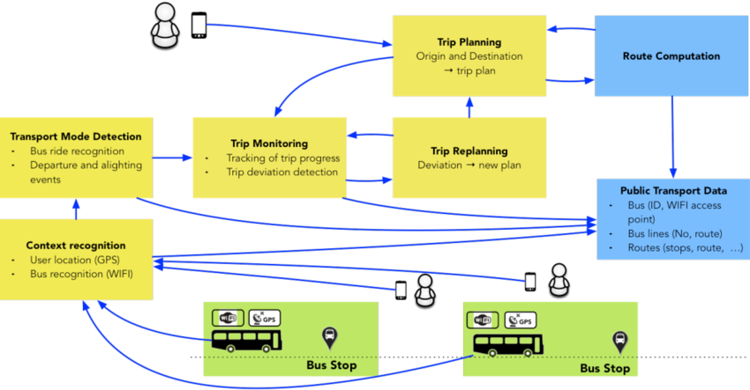
Bus Network Database

Slide 3

Role in Group Activity
My role in this group activity is to lead and provide ideas.
Generating data
Analysing and Testing
Generating final technical report

Slide 4

Approach and Methodology Used for the Project
Requirements Gathering:
Identified the requirements for the bus network
Analysed information about the type of data
Conceptual Design:
Created Entity Relationship Diagram (ERD)
Identified key entities like: bus company, bus, route, trip, passenger and many more.
Logical Design:
Converted conceptual design into logical design
Selected appropriate database (in my case I chose Neo4J)
Testing and Evaluation:
Tested for functionality, usability and performance
Evaluated against original requirements and make any necessary adjustments

Slide 5
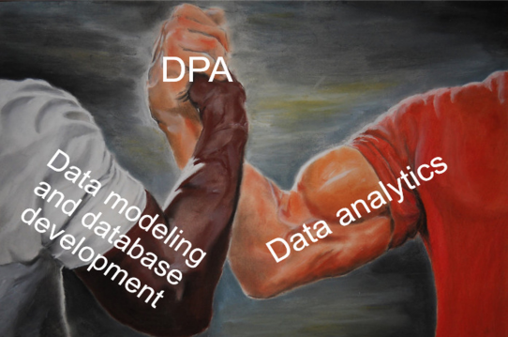

My Contribution to the Final Submission
Task A:
Designing and implementing the database
Converted conceptual design into logical design using Neo4J
Optimized the database for performance and scalability
Conducted testing to ensure its reliability
Task B:
Selected “Wrapper” based method for feature selection

Slide 6

TASK A

Slide 7

Data Modelling for the Bus Company Entity

Slide 8
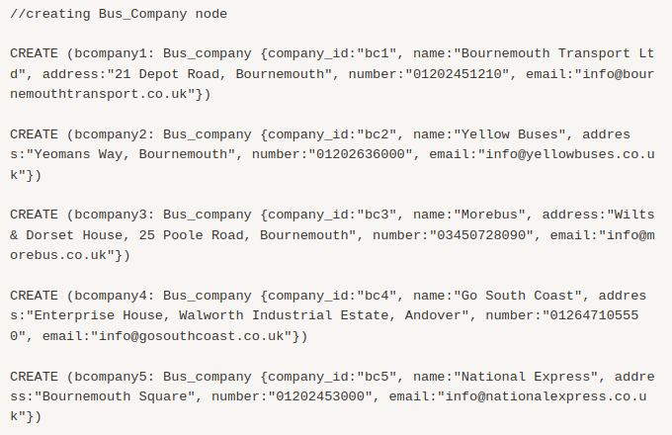
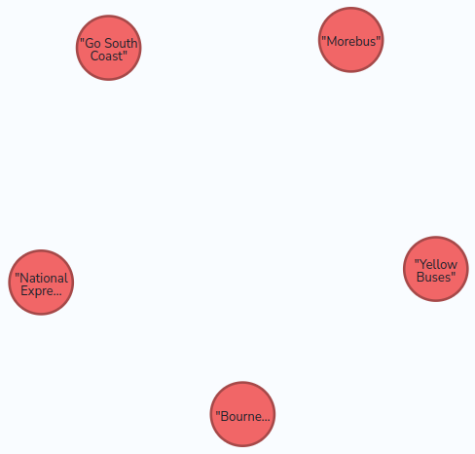
Bus Company Node
Created five bus companies and their information inside bus company node
Bournemouth Transport Ltd
Yellow Buses
Morebus
Go South Coast
National Express

Slide 9

Data Modelling for the Bus Entity

Slide 10
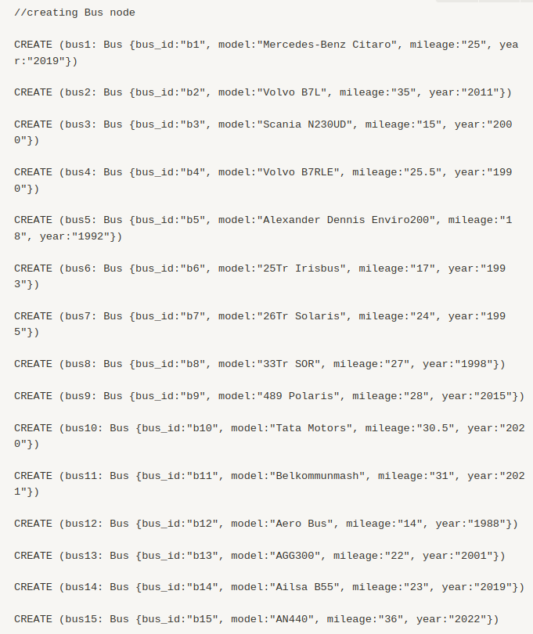
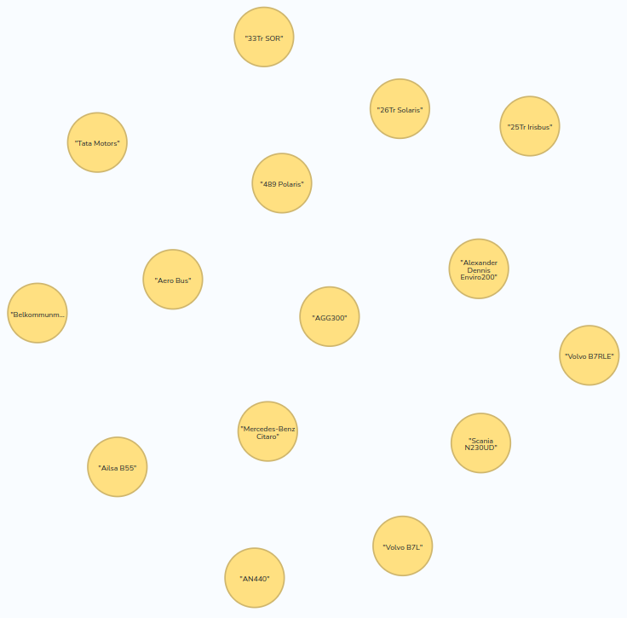
Bus Node
Created 15 different bus models and their details inside bus node
Model
Mileage
Year

Slide 11

Relation Between Bus Company and Bus Nodes

Slide 12
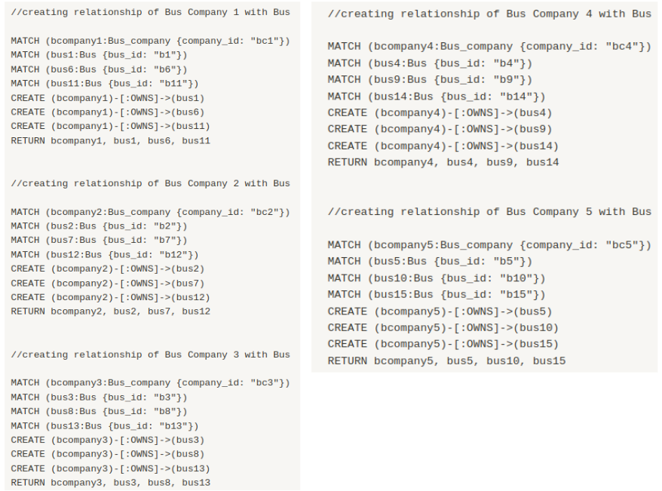
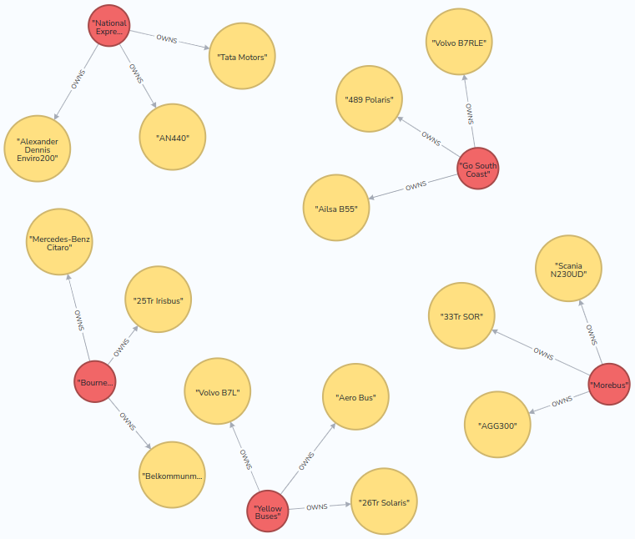
Relation between Bus Company and Bus Nodes
Created relation between bus company and bus nodes using “OWNS” relationship type.
Assigned three bus for each
Alternatively, one bus company owns three buses and shows one-to-many relationship between them.

Slide 13

Data Modelling for the Route Entity

Slide 14
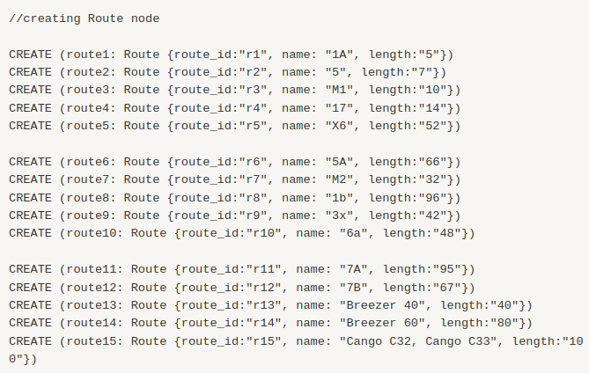
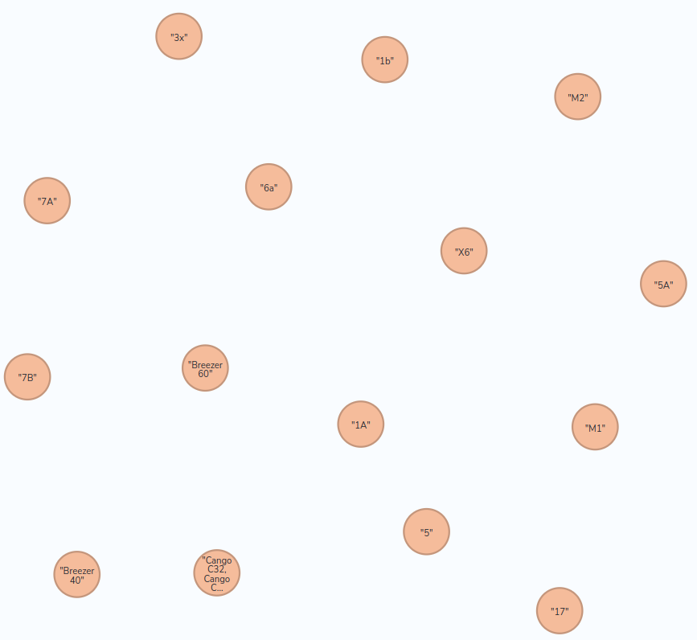
Route Node
Created 15 different bus route inside route node.
Name
Length

Slide 15

Relation Between Bus and Route Nodes

Slide 16
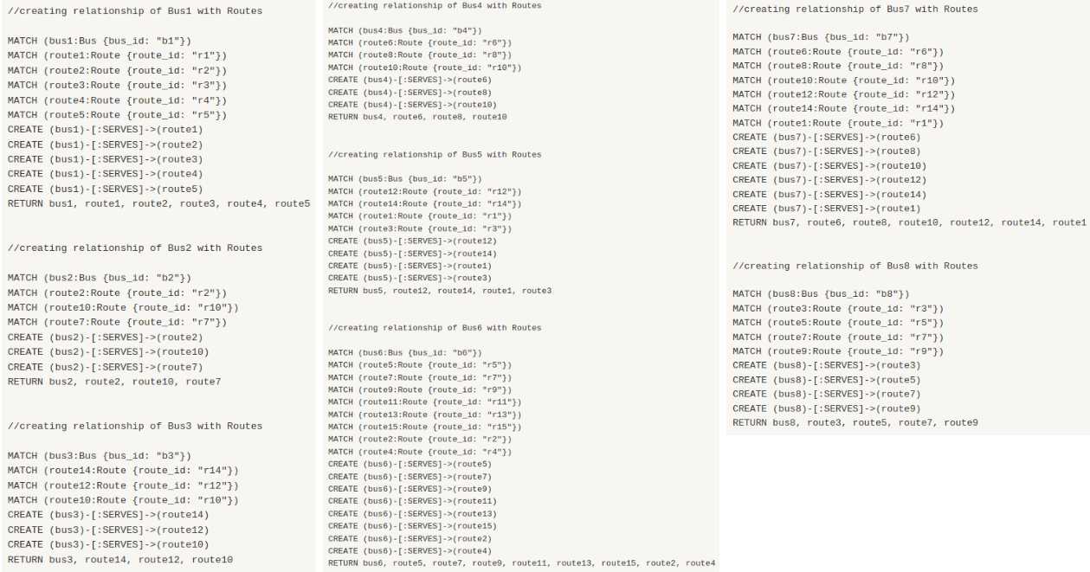
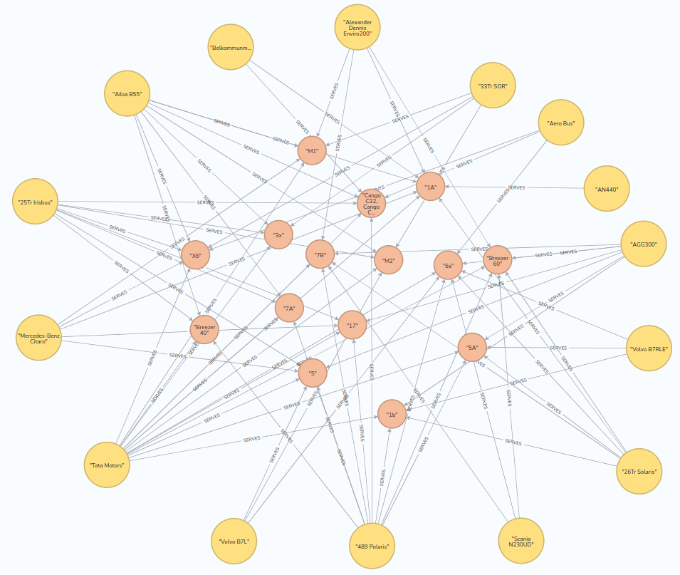
Relation between Bus and Route Nodes
Created relation between bus and route nodes using “SERVES” relationship type.
One route can serve one or multiple bus

Slide 17

Data Modelling for the Trip Entity

Slide 18
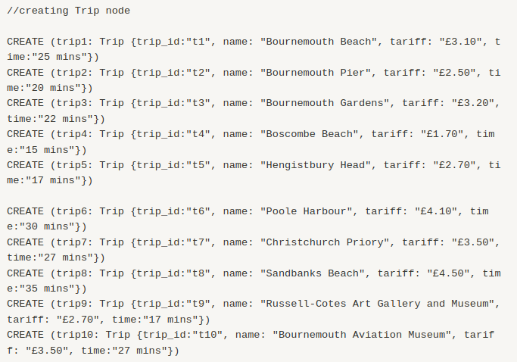
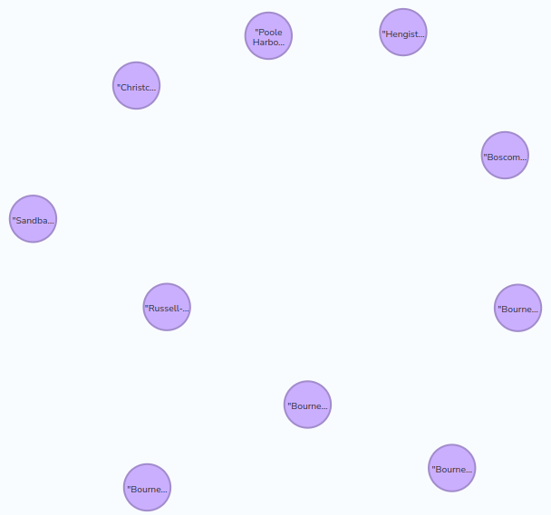
Trip Node
Created 10 different trip destination inside trip node.
Name
Tariff
Time

Slide 19

Relation Between Route and Trip Nodes

Slide 20
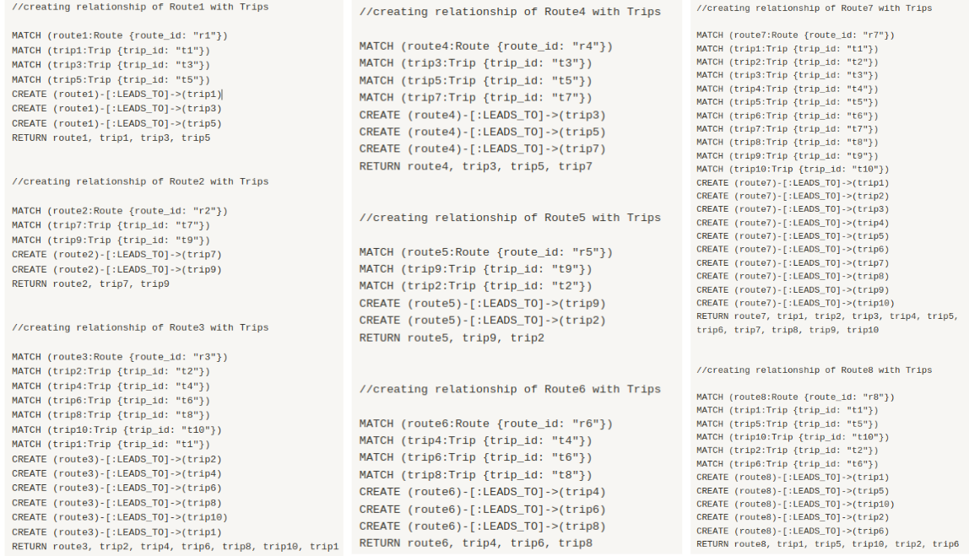
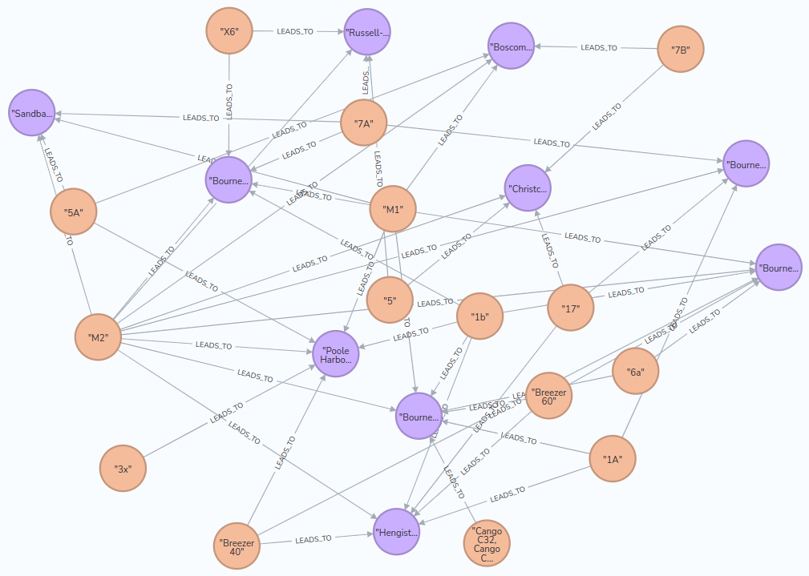
Relation Between Route and Trip Nodes
Created relation between route and trip nodes using “LEAD_TO” relationship type.
It shows which route takes which destination
One route can take multiple destination

Slide 21
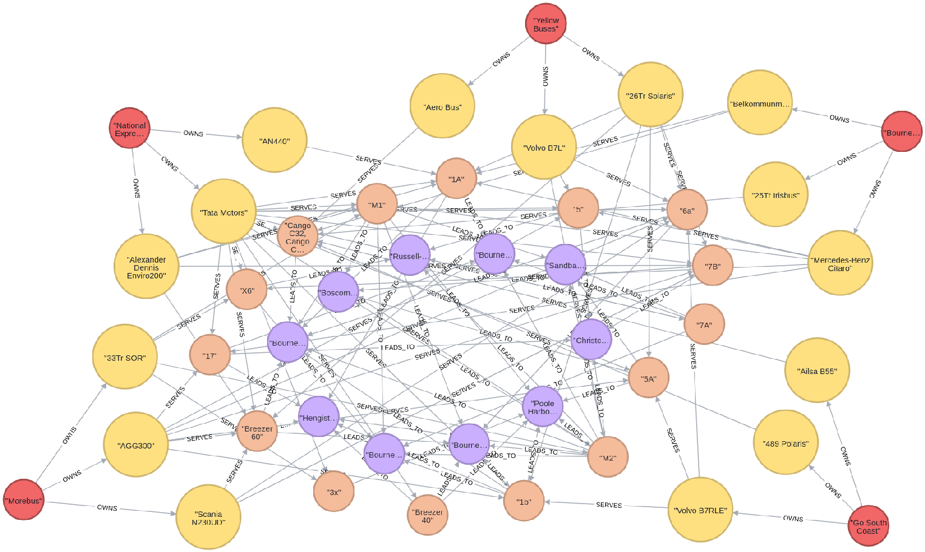
Outcome

Slide 22

Test Cases

Slide 23
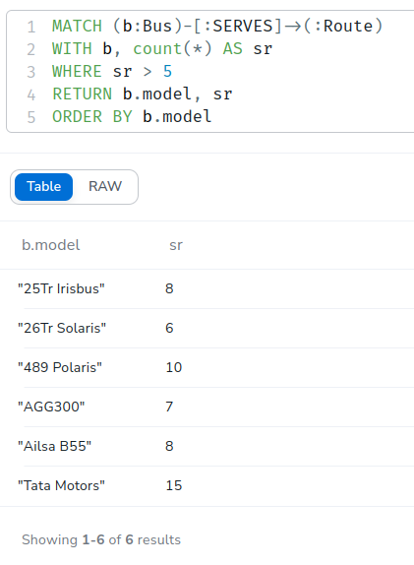
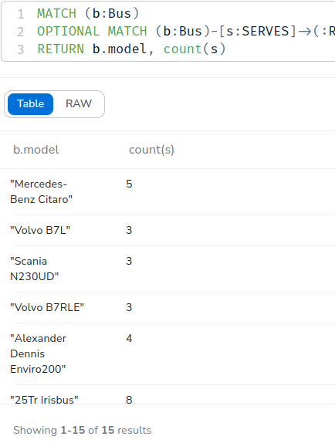
Test case 1 and 2
Test Case 1:
Picks all "Bus" nodes that have a "SERVES" link to a "Route" node.
Saved as a variable sr
Filter: sr > 5 and returns bus model and number of routes it operates
Test Case 2:
Picks the bus node and finds optional matches with route node using “SERVES” relationship type.
Displays model of bus and number of routes each bus model serves.

Slide 24
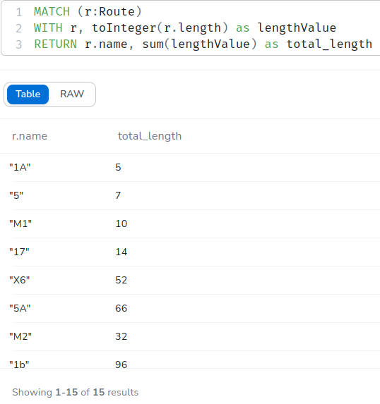
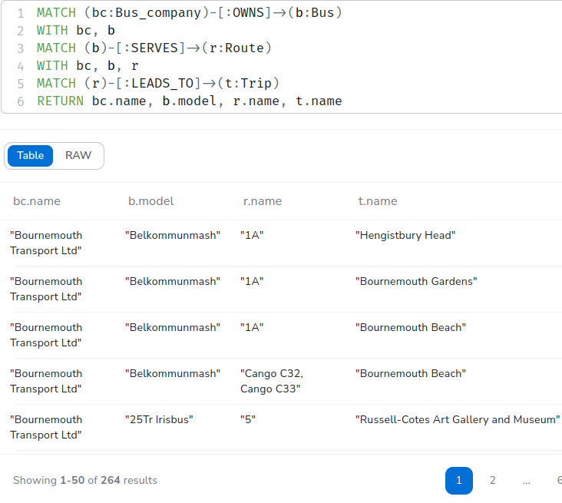
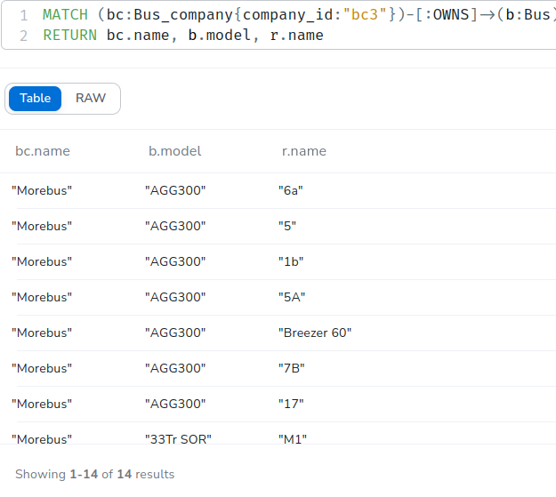
Test Case 3, 4 and 5
Test Case 3:
Picks route node
Change length from string to integer
Calculate sum
Test Case 4:
Match bus company that “OWNS” bus “SERVES” route “LEADS_TO” trip
Test Case 5:
Match bus company node
Filters bc3
Returns name, mode and route name

Slide 25
TASK B

Slide 26

Feature Selection Method

Slide 27
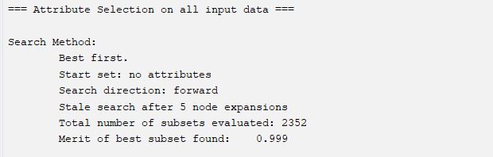
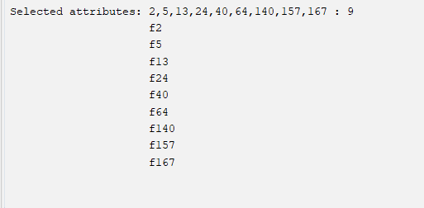
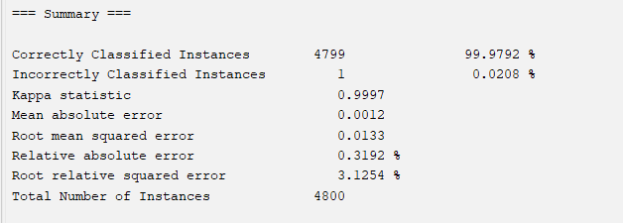
Wrapper Based Feature selection
Uses decision tree classifier, J48
Used “WrapperSubsetEval” method
Evaluated = 2352
Best subset found = 0.999
Selecting attributes can reduce the dimensionality of the dataset and potentially improve the performance of our model.

Slide 28

Steps Followed to Complete the Task
We divided task into subgroups
Assigned the task
Set the milestones
Had group meeting every weekend
Testing and analyzing
Used GitHub for code and document sharing between group members
Most important we discussed most of the unknown things with our module leader.

Slide 29

Summary and Conclusion
It was fun working with:
Neo4J graph database
Creating technical report
Data analysing tools like weka
Learned more about ERD and relations
Teamwork
In conclusion:
While designing a bus network database, I read many research papers and learned about how bus network-related apps work in real time, which is useful knowledge to have as a "Data Science" student.

Slide 30


